Slide 1
ADAPTIVE CAPACITY AS A PROACTIVE APPROACH
A dissertation submitted by PhD candidate
Charlotte Gorley
FIELDING GRADUATE UNIVERSITY
October 11, 2012
Notes:
Welcome everyone, to the presentation of my research. I’m delighted to share my work with you and hope you enjoy the presentation.

Slide 2
Presentation Outline
Objective
Definitions
The Need
Current Literature
Framework, Question, & Methodology
Findings
Strengths, Limitations, & Future Studies
Contribution, Implications, & Implementation
Acknowledgements
Notes:
Let’s get started!
The agenda we’ll follow is on this slide, and I’ll quickly step you through what I’ve planned.
We’ll first look at the objective of the research and some operational definitions of terms you’ll hear throughout the presentation.
We’ll take a look at the need and the reasons why this research is of interest to non-profit organizations today.
I’ll briefly talk about the literature, the framework, the research question and the methodology of this work.
Next we’ll examine the findings, along with the strengths, limitations of this study, and some areas where future research could be conducted.
We’ll also see how this work contributes to the knowledge pool and how non-profits could use it to increase their adaptive capacity.
I’ll finish by expressing my gratitude to those who supported me through this journey.

Slide 3

Objective
To add new knowledge to our current understanding of adaptive capacity in non-profit organizations
Notes:
The objective of this study was to identify the elements that best enable non-profit organizations to successfully and proactively adapt to changing operating environments, service demands, demographic shifts, and stakeholder expectations.
Permission to use: Dreamstime Royalty-Free Images

Slide 4
Operational Definitions
Adaptive Capacity:
A dynamic, organic approach to proactively preparing for change and anticipating that unpredictable forces will shape an organization’s surroundings
Non-Profit Organization:
An organization that invests any net earnings back into programs or services instead of distributing to shareholders or owners
Notes:
I have defined the terms adaptive capacity and non-profit organization as shown here.
The findings in this study may apply to for-profit organizations as well, but the scope of this research was focused on non-profit organizations.

Slide 5
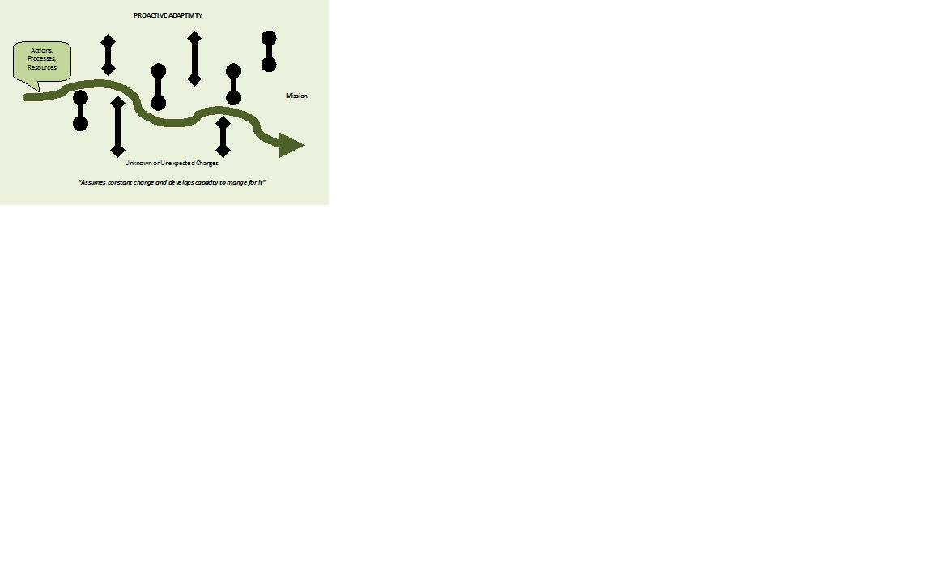
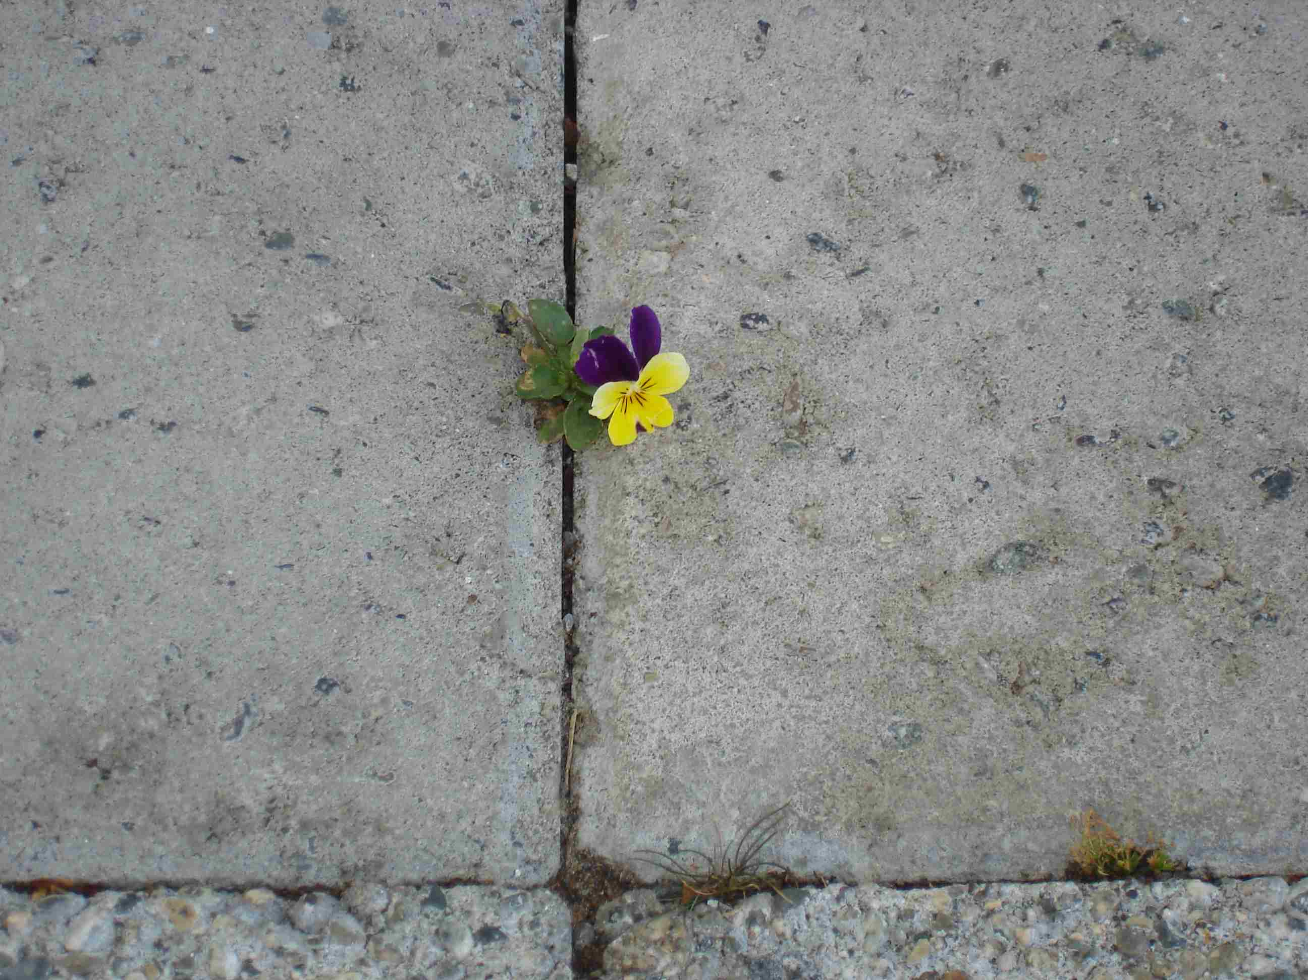
Proactive Adaptation
Notes:
Organizations can approach change in a proactive or reactive manner.
We’ll look first at a proactive approach in this diagram.
Organizations that demonstrate adaptive capacity adjust to changes with little chaos or disruption. We can see a smooth path incorporating actions, processes, and resources, with the mission of the organization clearly in mind.
These non-profits acknowledge the inevitability of change and regard constant change as the norm.
They expect the unexpected.
They purposely forecast and anticipate changes and are open to making many small, cumulative adjustments based on signals and information and assume that changes will be necessary.
They demonstrate resilience by continuing to function with less loss of productivity. They direct resources to address the changes, and recover quickly. Like the pansy in the photo, they maneuver around obstacles and continue on.
They are less at risk of being forced to make a catastrophic change.

Slide 6
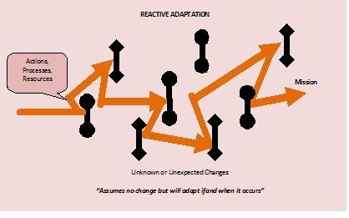
Reactive Adaptation
Notes:
This diagram shows what happens when organizations do NOT demonstrate adaptive capacity.
They bump into the changes and REACT.
They may lose valuable market time, opportunities, and possibly some personnel.
The net result is that even when they survive the change, it has come at greater cost and risk.
I make the distinction that reactive adaptability is the ability to adapt to present conditions and react to changes in the environment, and proactive adaptability is the capability to forecast changes based on signals and prepare to adapt to future circumstances.

Slide 7

The Need
Notes:
Why does it matter whether a non-profit is proactive or reactive?
Why do we care how they are impacted by change?
We care because our society depends on the services of non-profits so we need them to succeed.
In some cases we are reaching a point where there are more people wanting to access the services and the ratio of people to available services is shifting.
A problem is emerging in that change is inevitable and coming from several different areas, yet many attitudes and business systems often assume a status-quo environment and presume a false sense of stability.
I’ll give you some examples that may be the source of game-changers for a non-profit.
Changes to legislation that affect the non-profits’ business. For example, in the province where this study took place a harmonized sales tax (HST) was introduced. This required non-profits to reconfigure their tax collection and remittance processes. Further upheaval was experienced when the tax reverted back to the provincial sales tax and goods and services tax.
The political environment is always a factor. Elections occur and governments change, potentially causing significant repercussions to non-profit businesses.
Industry regulations such as safety certifications can change, making it necessary for non-profits to change their operating procedures or adhere to new certification requirements.
We can’t overlook the impact technology has on non-profits. New options like Facebook, Twitter, and other programs and the corresponding learning curve cause continuous changes in processes and expectations.
Societal shifts also drive change. Attitudes, mindsets, preferences are constantly shifting. An example of how this affects non-profits is the trend towards recycling and other green practices, along with an expectation of increased accountability and transparency.
Demographic shifts drive change with a force unseen until the baby boomer generation. Seniors’ needs for products and services is the most visible evidence of this game-changer. Many non-profits that depend on volunteers are reporting challenges in recruiting volunteers.
The market also dictates changes. The competition to deliver faster, smaller, cheaper products and services is a constant pressure. The market also drives changes in a non-profit’s structure and size corresponding to market demand. In order to be profitable they may need to downsize, upsize, or right-size.
Economic conditions affect funding sources and the number and type of contracts a non-profit can pursue. This in turn affects their revenue and costs. Another economic driver that affects non-profit organizations is the rate of inflation.
If a non-profit is working in a market influenced by environmental standards and concerns, they can add that to their list of game-changers. For instance, a non-profit that produces or sells organic foods is subject to a range of standards and regulations that shift on a regular basis.
A non-profit may find itself facing changes in some, or even all of these areas so the ability to challenge the established ways of thinking and doing business is essential to accommodate game-changers.
Copyright permission obtained from iStock photos

Slide 8
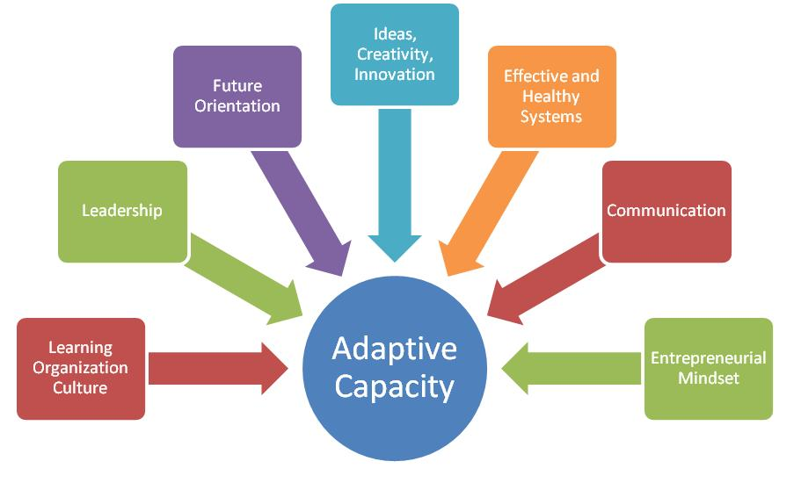
Current Literature
Notes:
The literature review revealed a substantial body of literature on organizational change, and we know the landscape is changing at a constant and increasing pace.
Themes from the literature review emerged and although they are illustrated separately in this diagram, they in fact overlap and should be viewed together, as a system in order to best understand the interplay.
The authors included in the literature review all developed theories about these elements, combining different elements in their theories.

Slide 9
Current Literature
Learning Organization Culture
Perkins et al, 2007
Heifetz, Grashow, & Linsky, 2009
Hargrove, 1995
Leadership
Jaskyte, 2004, 2011
Schein, 1992
Heifetz, Grashow, & Linsky, 2009
Notes:
This slide, and the next two, list the key authors in the literature review.
Learning Org:
The authors that looked at the aspects of a learning organization tell us that learning involves changes in beliefs, attitudes and behaviours beyond the acquisition of new information and that these changes are the only way adaptive challenges can be successfully met.
Leadership:
The authors that studied leadership emphasized that the right kind/style of leadership is important for the context and that leaders who can mobilize people to take on the challenges of change are essential to proactive adaptability.

Slide 10
Current Literature
Ideas, Creativity, Innovation
McDonald, 2007
Jaskyte, 2011
Effective & Healthy Systems
Senge, 1990
Epstein, 2008
Mitchell & Learmond, 2010
Future Orientation
McDonald, 2007
Jaskyte, 2011
Notes:
Ideas, Creativity, Innovation:
The authors who focused on ideas, creativity, and innovation think that innovation is a basic requirement for building adaptive capacity.
Effective, Healthy Systems:
Looking at the material on effective, healthy systems, we see that it is necessary to view the system as a whole rather than isolate the components and that the system expands outside the organization’s walls and includes external contacts and entities. We also learn that the connection points in a system are key areas to observe.
Future Orientation:
Reading about future orientation, we learn that organizations with a clearly stated mission statement were better equipped to align innovations toward it.

Slide 11
Current Literature
Communication
Heifetz, Grashow & Linsky, 2009
Schein, 1992
Senge, 1990
Entrepreneurial Mindset
McDonald, 2007
Christensen & Ebraham, 2007
Mitchell & Learmond, 2010
Staber & Sydow, 2001
Scott & Davis, 2007
Notes:
Communication:
The authors agreed that communication is the cornerstone of a healthy and effective system, including access to information because that seems to lead to a higher rate of idea generation.
Entrepreneurial Mindset:
The research on entrepreneurial mindset indicates that empowerment is essential to building adaptive capacity, and engaging people is key to unleashing adaptive capacity.
We also learn how important it is to encourage thinking in the future, forecasting and preparing for circumstances that may or may not occur.
We must remember too that contingency theory is important to consider. Different environments, context, place and time, require different things and a cookie cutter approach is not useful.
The literature review revealed a set of themes, but it was clear there is no single formula that will guarantee adaptive capacity. That learning helped to shape the research design.

Slide 12
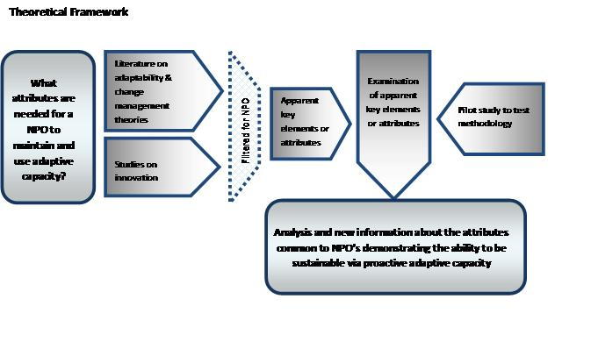
Framework
Notes:
After looking at the existing literature and research on adaptability, change, and innovation, I filtered the material through the non-profit organization lens because the purpose of the research is to add new knowledge to our current understanding of adaptability in non-profit organizations.
The framework that is diagramed here supports the study by providing a clear path that includes a review of the literature and the data collected from participants who are influenced, impacted, and affected daily by change.
By comparing what the literature holds with the current experience of participants, this research adds a rich dimension to the literature.
The diagram depicts the variables and their relationships that comprise the theoretical framework that guides the study.
The research connects the elements of the framework together and provides the setting for participants to describe adaptability as they see and experience it.

Slide 13

The Question
How do non-profit organizations develop and exhibit the capacity to proactively adapt to change?
Notes:
This question explores how stakeholders of non-profit organizations view their organization’s capacities to proactively adapt to changing environments.
This research reveals what the participants said they thought contributed to adaptive capacity in their non-profit organization and compares their experience of adaptive capacity with the themes from the literature review.
Image obtained by “no copyright images xxx xxx=question mark”

Slide 14
The Sub-Questions
What kind of changes do you see in the work you do with your non-profit?
What internal changes are affecting your non-profit organization?
What external changes are affecting your non-profit organization?
How do you view adaptability in your non-profit organization?
Can you share a story about how your non-profit organization adapts to change?
What do you think your non-profit organization needs to continue to do?
What do you think your non-profit needs to change?
In your view, how should a non-profit address these changes?
Notes:
The sub-questions support the research by asking about elements pertinent to adaptive capacity in non-profit organizations.
They explore the nature of changes that participants are noticing, internally and externally.
Participants were asked to share their views on adaptability as they experienced and observed it, and were invited to share examples to illustrate their experience.
They were also asked what adaptations they think will be needed in the future and what those adaptations will require.
Image obtained by “no copyright images xxx xxx=question mark”

Slide 15
Research Methodology
Grounded Theory
Semi-Structured Interviews
Pilot Study
  Consent
  Digital Recording
  Transcription
Formal Research
Data Analysis using NVivo Software
Notes:
This slide outlines the research design for the study.
Grounded theory was chosen for this research because it was consistent with my belief that the participants possessed the information that would answer the research question. It also provided a structured way to analyze the data and discover the collective knowledge of the participants.
The semi-structured interviews support the questions and provided the participants the opportunity to share their insights, describe their experiences, and reflect ‘in conversation’ how they view adaptability and what it means in their organization.
I conducted a pilot study first and interviewed 5 participants from 2 non-profit organizations.
The purpose of the pilot study was to test the feasibility and effectiveness of the process, starting with recruitment and eligibility of participants and protocols in contacting them.
It was an opportunity to assess the materials and instructions participants were provided with, and test the effectiveness of the proposed questions for clarity, sequence, and timing.
It also afforded a chance to test the equipment and my process such as digital recording and transcription, and to identify any logistical problems prior to beginning the formal research.
It was a good test run for the logistics of conducting the research, the value of the interview questions in relation to the research question, and the data collection and analysis approach.
I then interviewed an additional 7 participants from 3 more non-profit organizations following the same process as for the pilot study.
Data analysis was done using NVivo software and incorporated coding practices learned from material by:
Graham Gibbs
Johnny Saldana
Lynn Richards
The process is described in detail in my dissertation and references to these authors are included in the dissertation reference list.

Slide 16
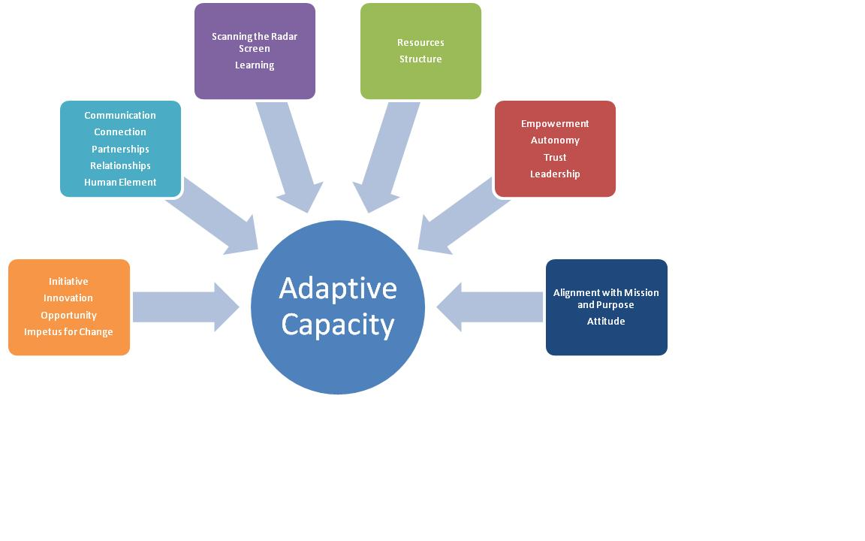
Findings
Notes:
This diagram is based on the codes generated from the data analysis process. In general, these are the areas the participants talked most about.
They are grouped together into the categories that are shown here AND it’s important to note that this is NOT the only way to look at the themes.
I want to emphasize that these groupings are not static. They can be combined in different ways and considerable overlap and intersection exists among the categories.
There are no clear boundaries separating the themes or points made by the participants. The threads that connect these themes are both the warp and the weft of the fabric of adaptive capacity, interconnecting the concepts and rendering it impossible to view them in isolation.
A diagram cannot do justice to the organic nature of these themes but it is one way to communicate them so non-profit organizations can learn from them.

Slide 17
Findings
The Nature of Change-Drivers
Technology
Demographics
Societal Shifts
Economic Factors
Regulatory Requirements
Political Environments
Notes:
The participants identified these topics as the key drivers of change in their organizations. Some of these change-drivers are internal, some external, and some are both.
These elements are important because they effect both short-term operations and long-term planning.
Looking at each topic in turn ….
Technology:
Technology drives change in several ways. It requires an investment in hardware and software that need to be regularly updated. It requires services like web servers, and web page design, as well as training in the use and maintenance of these electronic systems.
New tools like Facebook and Twitter pop on the scene and can be overwhelming for staff and/or volunteers.
Client expectations about self-serve functions and short response times drive change.
For some, technology is required alongside traditional ways of communicating. They must incorporate technology while still maintaining the other media they have used in the past, balancing high-tech with high-touch.
Demographics:
We have a growing aging population and this drives not only changes in process, but in many cases changes in products or services.
It also impacts the volunteer and/or staff pool for non-profits, in turn impacting how these organizations retain corporate knowledge and approach succession planning.
Societal Shifts:
We have large numbers of working parents and single parent families today, and they have different preferences in their choice of services, activities and pursuits. They have many more options available making competition stiff for non-profits who offer programming.
And that programming needs to be seen as relevant to today’s world, acknowledging today’s lifestyles and interests.
Economic Factors:
In terms of economic factors, market demand brings opportunities and challenges.
The market also affects the size and structure of a non-profit and their ability to increase or downsize according to market fluctuations.
Regulatory Requirements:
Changes in regulations can force changes in what a non-profit offers and the way they deliver the product or service.
Political Environments:
Lastly, a change in government can mean a series of cascading changes in a non-profit’s world, and sometimes threaten their very existence.

Slide 18
Findings
What Participants Said
“It’s knowing that there’s this very fast trend out there with technology and knowing that we have got to do that and that we have to be making advances in that way because it’s going to become more and more but also knowing that there’s this whole group of people that need to be served in another way and there’s also this intangible thing that people gain at our programs that’s not just about information. It’s about connecting with others and feeling that they’re not so isolated and regaining that sense of emotional support and person connectedness and that has a value to it that’s very hard to quantify. ”
Notes:
This slide and the next one give examples of what the participants said.
This quote touches on the pressure that participants felt to keep up with change and yet to retain the essence of what their organization exists for.

Slide 19
Findings
What Participants Said
“It’s having enough balance so there’s enough structure that there’s some consistency and safety and some adherence to the things that have to be adhered to while allowing the freedom to shape the program in a way that makes sense for each group.”
Notes:
This quote illustrates another kind of balance – that of having enough structure for consistency, yet allowing for enough flexibility to adapt to change.

Slide 20
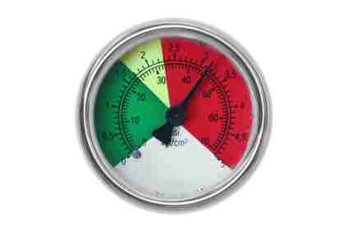
Findings
Participants’ Adaptability Gauge
Reputation for Providing Value
Solid Financial Management
Clear Identity & Vision
Partnerships, Relationships, & Collaboration
Continuous Learning
New Mindsets
Stretch Goals
Consistency
Notes:
I’ll talk a bit about some of the things participants identified as evidence that they were able to find the appropriate balance.
Reputation for Providing Value:
They talked about providing value by being able to compete in the marketplace, to be seen as making decisions with credibility and integrity, and displaying transparency and trust.
Solid Financial Management:
They defined solid financial management as demonstrating good business planning, and building enough surplus to ride out a lean time. A surplus, or a solid financial position also allows for taking calculated risks and allowing for innovative ideas to be implemented.
Clear Identity & Vision:
Several of the participants stressed the importance of being clear on the organization’s identity, mission, vision, and mandate. This clarity allows a non-profit to make objective decisions regarding opportunities and prevents mission drift.
They said it was important to revisit the vision to keep it in step with today’s world, and to make sure that newcomers were engaged with the vision. They considered it crucial that people see their contribution’s place in the vision and their role in the big picture.
They emphasized that the board’s role is to provide vision and direction so that staff and volunteers can make the vision come true.
Partnerships, Relationships, & Collaboration:
The connections, partnerships, and relationships within the non-profit, with other non-profits, and with external organizations and groups was deemed essential and indicates an awareness of the larger system.
Continuous Learning:
Participants identified continuous learning as a key indicator of adaptability and saw it closely tied to building partnerships and relationships.
They included environmental scanning as a way to constantly learn what was happening in their sector and in other sectors, and what was coming down the pipe that was worthy of their attention.
This entails being aware of the best sources of information, evaluating the information, and acting on what is appropriate or feasible.
New Mindsets:
Mindsets in this context refer to how people view the organization. For example, one participant shared how they reframed what they do from ‘offering training’ to being a ‘capacity development provider’.
Participants talked of learning to accept and expect change and finding ways to make it a positive experience, individually and collectively.
Stretch Goals:
A good gauge of adaptability is how willing an organization is to push the envelope and ask “What if?”
This practice requires new ways of working and setting aside “The way we’ve always done it.” to identify new targets, objectives, and stretch goals.
Consistency:
Another indicator of adaptability is how an organization balances consistency and standards against adaptability and innovation.
It’s a skill to be able to discern which parts need to be consistent and which parts can be innovative.
For example, consistency in language, brand, and common promise can provide stability and a foundation which can actually support flexibility.
This allows a non-profit to stay true to their vision and core purpose while customizing or updating services or products.
Copyright permission obtained from iStock photos

Slide 21
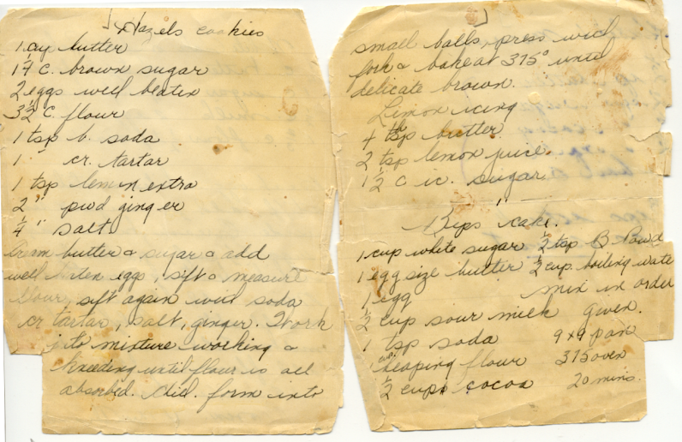
Findings
What Does It Mean?
Adaptive capacity exists when the necessary elements are present in the right combination. People, circumstance, resources, connections, opportunity are the ingredients for adaptive capacity.
Which ingredients are
combined, to what extent,
determines adaptive
capacity for the particular
non-profit organization.
Notes:
What does this mean?
The non-profits that were included in this research have different objectives and are in different circumstances so a rich collection of insights to draw on and address the question is available.
Given the variety of mandates, viewpoints, and sizes of the organizations, it is not surprising that a concise, definitive conclusion of what it takes to develop adaptive capacity and exhibit it clearly cannot be easily drawn. There is no single formula or recipe that will produce adaptive capacity.
The factors that contribute to adaptive capacity are organic and the level of adaptive capacity may be quite different depending on which ingredient is missing or in over-abundance.
In every recipe there is a balance that produces the intended result.
Photo taken by Charlotte Gorley

Slide 22
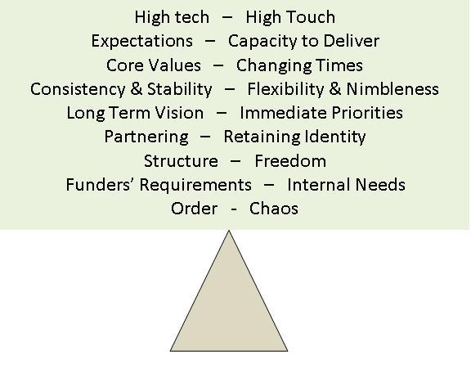
Findings
Tensions & Balance
Notes:
I’ve mentioned balance a few times already, and this diagram illustrates the forces, conditions, or considerations that are at work in the non-profit organizations in this study.
From the beginning, there was a need to balance the differences between the literature review and the findings.
Some topics bear some similarity, although the participants view the dimensions through a different lens than the authors in the literature review did, so their views on the topic do not always align completely.
As we saw in an earlier slide that illustrated the themes that the participants’ comments generated, dynamics among the elements is an important catalyst for adaptive capacity. The relationships between the elements reveal an organic, rather than a linear relationship.
One of the authors I cite in the dissertation suggests this combination of active ingredients is a complex adaptive system, constantly interacting and rearranging themselves.
(John Holland in Fulmer, 2000)
It involves multiple and changing components, interacting with each other and external elements, evolving as needed and adapting to situations.
Even the relationships within the system may even be temporary, indicating fluid interdependencies instead of static ones.

Slide 23
Strengths of This Study
Rooted in the participants’ voices
Systematic and consistent research process
Cross-section of viewpoints
Pilot Study Conducted
Notes:
This research stands as a credible study for reasons shown on this slide.
In addition, the same set of questions was used for all participants.
The accuracy of the transcripts was verified with the participants and the participant list included volunteers, staff, and board members, providing a good cross-section of viewpoints.
The non-profit organizations selected for the study spanned a variety of domains. They aren’t named in the study to ensure confidentiality, but they cover a range of programs and they serve a diverse population.

Slide 24
Limitations & Future Studies
Small number of participants (12)
Small number of organizations (5)
Expand to larger geographic area
Expand beyond English speaking participants
Expand to differentiate between male and female viewpoints and/or by age group
Notes:
There were a relatively small number of non-profits and participants included, so there is room to expand on this research in the ways I have identified here.

Slide 25
Contribution & Implications
These findings can enhance the ability for non-profit organizations to develop adaptive capacity to better serve the communities and programs they support.
Using these findings, non-profit organizations can tailor their actions and approaches to build adaptive capacity in their organizations.
An unintended benefit is that it got people thinking about adaptive capacity and how it was demonstrated in their organization.
Notes:
I think what’s most important is how this study has raised awareness of adaptive capacity in the participants and generated conversations about adaptive capacity that had not taken place previously. Questions were raised that had previously gone unasked. It would be interesting to touch base with the organizations in this research a year from now and see if there is evidence that the increased awareness has made a difference in their capacity for adaptation.
As a result of these findings, leadership educators or OD professionals may look at their programs differently and assess their teachings about change and adaptability.
Executive coaches may approach their work with clients in a different way when contracted to work with leaders.
Human resources departments may take a fresh look at how they evaluate and reward employees and adjust their hiring practices, as one non-profit in this study has done.
The implications for anyone in, or associated with, a non-profit workplace today could be impacted by the results of this study.

Slide 26
Implementation
Awareness of the nature of changes in the external environment and the internal culture
Cultivating a culture that is comfortable with ongoing change and hiring accordingly
Examination of internal processes
Build diversity in funding sources, expertise, products and services
Foster transparency, trust, respect, integrity and credibility – walk the talk
Notes:
This slide and the next one talk about some ways non-profits can action the findings of this research.
Based on the participants’ comments and my interpretation of their remarks, I have concluded that there are several things that can be used as building blocks to adaptive capacity.
The first is increasing awareness internally by listening and observing. That means asking questions and inviting conversations. Most importantly, it means making time and space for those conversations to occur. It means sending the message that cultivating adaptive capacity is not something regulated to be done off the side of the desk, or something to be done ‘in peoples’ spare time’.
Another way to increase awareness externally is by actively participating in networking, attending conferences, reading trade journals, and reading research reports….putting a finger on the pulse of change and looking for places and ways where a change might present itself.
They can actively look for ways to offer new services or products basing those decisions on what is learned by environmental scans.
Leaders at all levels can model a positive attitude toward change and a perspective based on seeing possibilities rather than closing doors.
They can make hiring selections that will shift the organization towards one with a positive attitude to change and build diversity in their talent pool.
Non-profit organizations can conduct internal process assessments and be ruthless about changing processes that don’t support adaptability.
They can look for a variety of funding sources and avoid putting all their eggs in one basket.
They can build a reputation for trustworthiness, honesty, and adding value.

Slide 27
Implementation
Encourage and mentor those that show adaptive capacity
Stay true to the core values of the organization
Create and tap into networks
Use technology and keep current
Notes:
Some other ways non-profits can implement the findings are by building depth by recognizing potential leaders who demonstrate skills in adaptive capacity and ‘paving the way’ for them to action innovative ideas that contribute to adaptive capacity aligned with the organization’s mission.
They can use the vision as a guide when assessing opportunities and ask “Why are we here anyway?” “What does this organization exist to do?”
They can connect with others who demonstrate adaptability and innovative ideas.
They can actively pollinate ideas and be open to partnerships that can advance the cause.
They can leverage technology and use Facebook, Twitter, and blogs as a way to both gather information about what’s trending and may be important to pay attention to, and to communicate ideas and raise awareness of products and services.
The information presented here is covered in much more depth in my dissertation, which is available on the Triangle Resources webpage address in the last slide.

Slide 28

Acknowledgements
Al Gorley
Notes:
In closing, I’d like to acknowledge and express my thanks to some very important people who made is possible for me to be at this point today.
I’d like to first thank my husband, Al, for his ongoing confidence in my abilities and unfailing belief that I can do whatever I set out to do. Al is my rock and I couldn’t have done this work without his support.
Al read my papers, gave me feedback from a ‘fresh eyes’ perspective and joined in countless conversations about my research.

Slide 29

Acknowledgements
Dottie Agger-Gupta
Notes:
Next I’d like to thank Dottie Agger-Gupta, my dissertation committee chair.
Dottie, I can’t thank you enough. Dottie interviewed me as a potential student in the HOD program, was an influence at my NSO, and continued to be a role model for me throughout this journey.
Dottie has my eternal admiration. Always professional and always calm, Dottie exemplified grace and style in her work with me as a mentor, and as an assessor. She is a master of giving feedback and imparting wisdom in a manner that always demonstrates a supportive presence. Thank you, Dottie. You have been a wonderful guide.

Slide 30
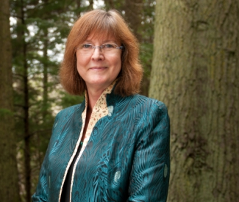



Acknowledgements
Jo-Anne Clarke
Student Reader
Brigitte Harris, PhD
External Examiner
Leonard Baca, EdD
Faculty Reader
Nancy Wallis, PhD
Faculty Reader
Notes:
And a big thanks to the rest of my dissertation committee.
Brigitte Harris
I am grateful that Brigitte Harris, my external reader has been part of my committee. It feels like we’ve come full circle. Brigitte wrote a letter of reference for me when I applied to Fielding and she has been interested in my work throughout the program. Her attention to detail made my dissertation a work that I am truly proud of.
Leonard Baca
Leonard Baca is one of my faculty committee members. Leonard’s constructive critique required me to think deeply about the components of a research project, and this is something that will benefit my future work. Thank you, Leonard, for your insightful comments, and for your support throughout this process.
Jo-Anne Clarke
Jo-Anne Clarke, my student reader was a member of my anchor team at our NSO four years ago. It is a privilege to have her on my committee and to share in our Fielding journeys.
Nancy Wallis
Nancy Wallis is my faculty committee member. Nancy, I am grateful for your probing questions, and your interest in my work throughout the dissertation process. The questions you posed pushed me to more fully develop the ties between the theories that were identified in the literature and create solid links between the research, the literature, and the context.
Thank you all again for your contribution to my scholar-practitioner learning and development and for supporting me to do my best work.
Daphne Rintoul
I also want to extend my thanks to Daphne Rintoul who transcribed hours and hours of audio for me and saved me time and sanity.

Slide 31
Questions?
Notes:
That concludes my presentation on Adaptive Capacity as a Proactive Approach.
I’m so glad you could join me today and share the culmination of this research work.

